Slide 1
Overview Presentation
www.simple-help.com
© simplehelp ltd

Slide 2
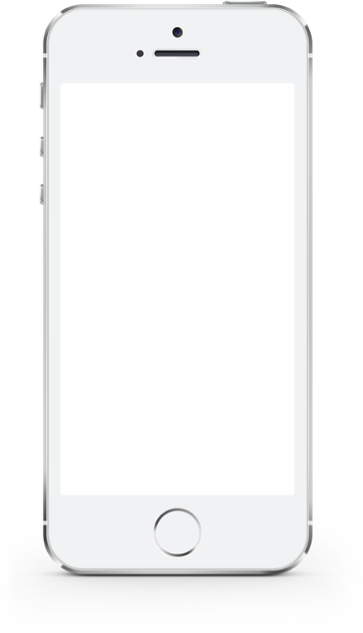
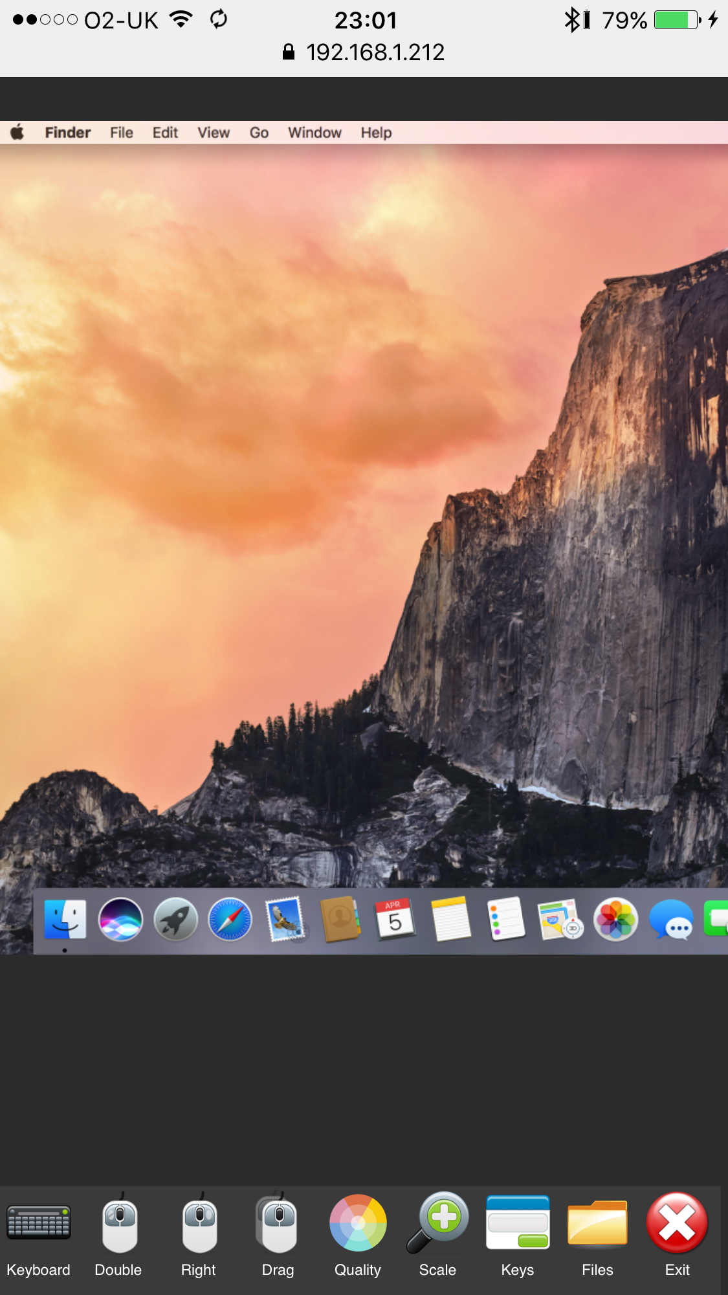
Critical Systems
Computer infrastructure is the backbone of every business today
Technicians need tools to anticipate problems, apply fixes on demand, manage maintenance
Issues resolved quickly mean productivity and efficiency gains, happier employees
www.simple-help.com
© simplehelp ltd

Slide 3
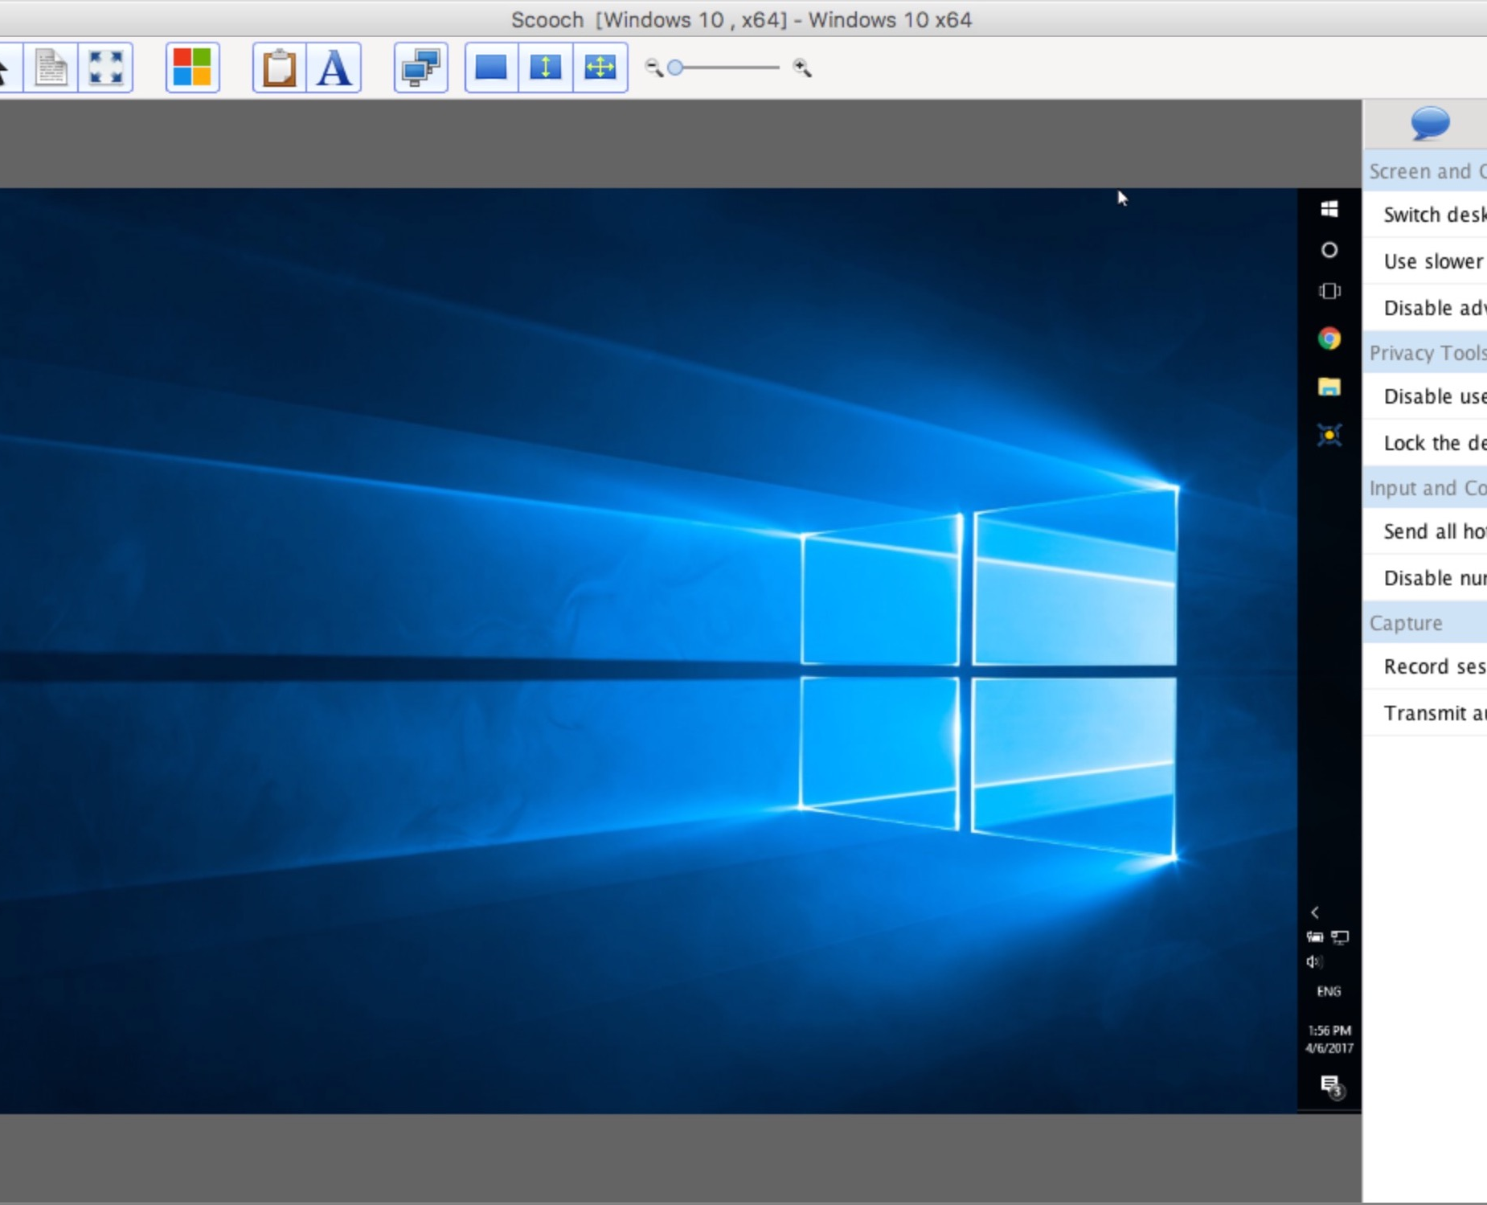
SimpleHelp
Maximise uptime for employees and management
Minimise downtime of critical systems
Reduce time to resolve issues
Streamline IT support department
Secure, internally managed remote access for employees and external contractors
www.simple-help.com
© simplehelp ltd

Slide 4
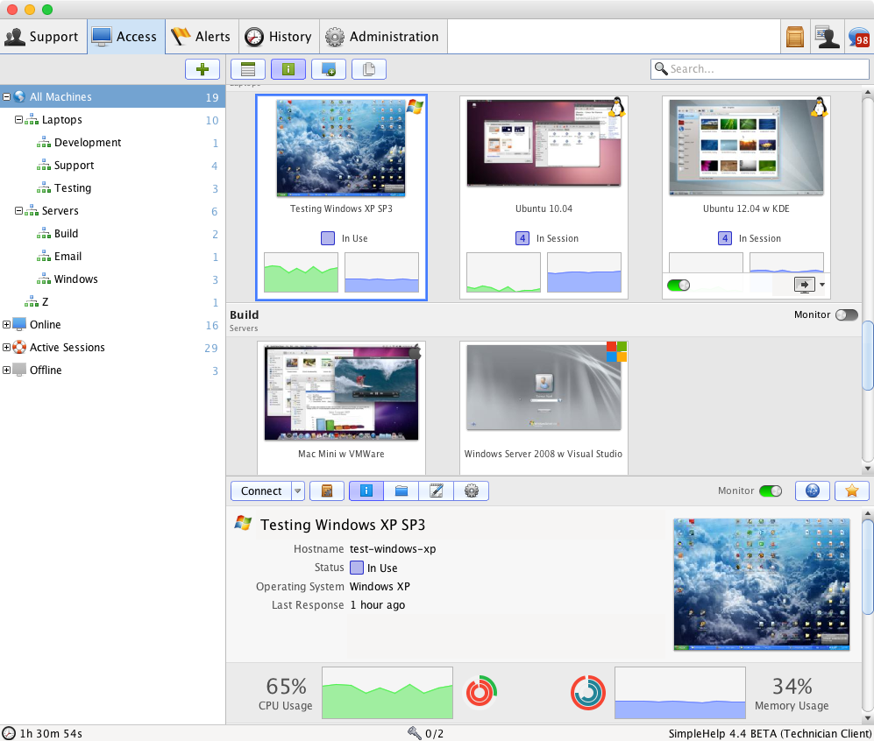
Remote Support
Users can easily request help
Technicians are notified, can prioritise virtual queues of users
Pertinent information is automatically gathered
Technicians can take control of the computer, chat with the user
Fewer physical visits, faster resolutions
www.simple-help.com
© simplehelp ltd

Slide 5
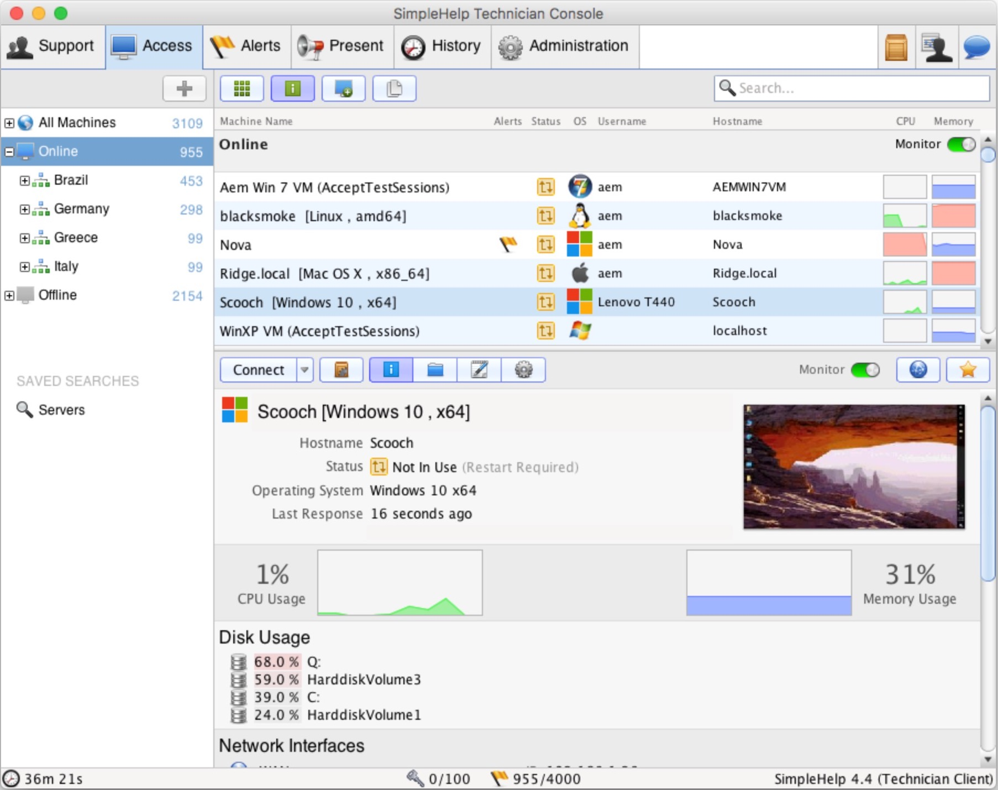
Remote Access
Can be installed from within support sessions or en-masse
Technicians can access machines unattended to apply fixes, maintenance
Live monitoring allows Technicians to diagnose problems at a glance
Users, contractors can be given secure, simplified remote access
www.simple-help.com
© simplehelp ltd

Slide 6
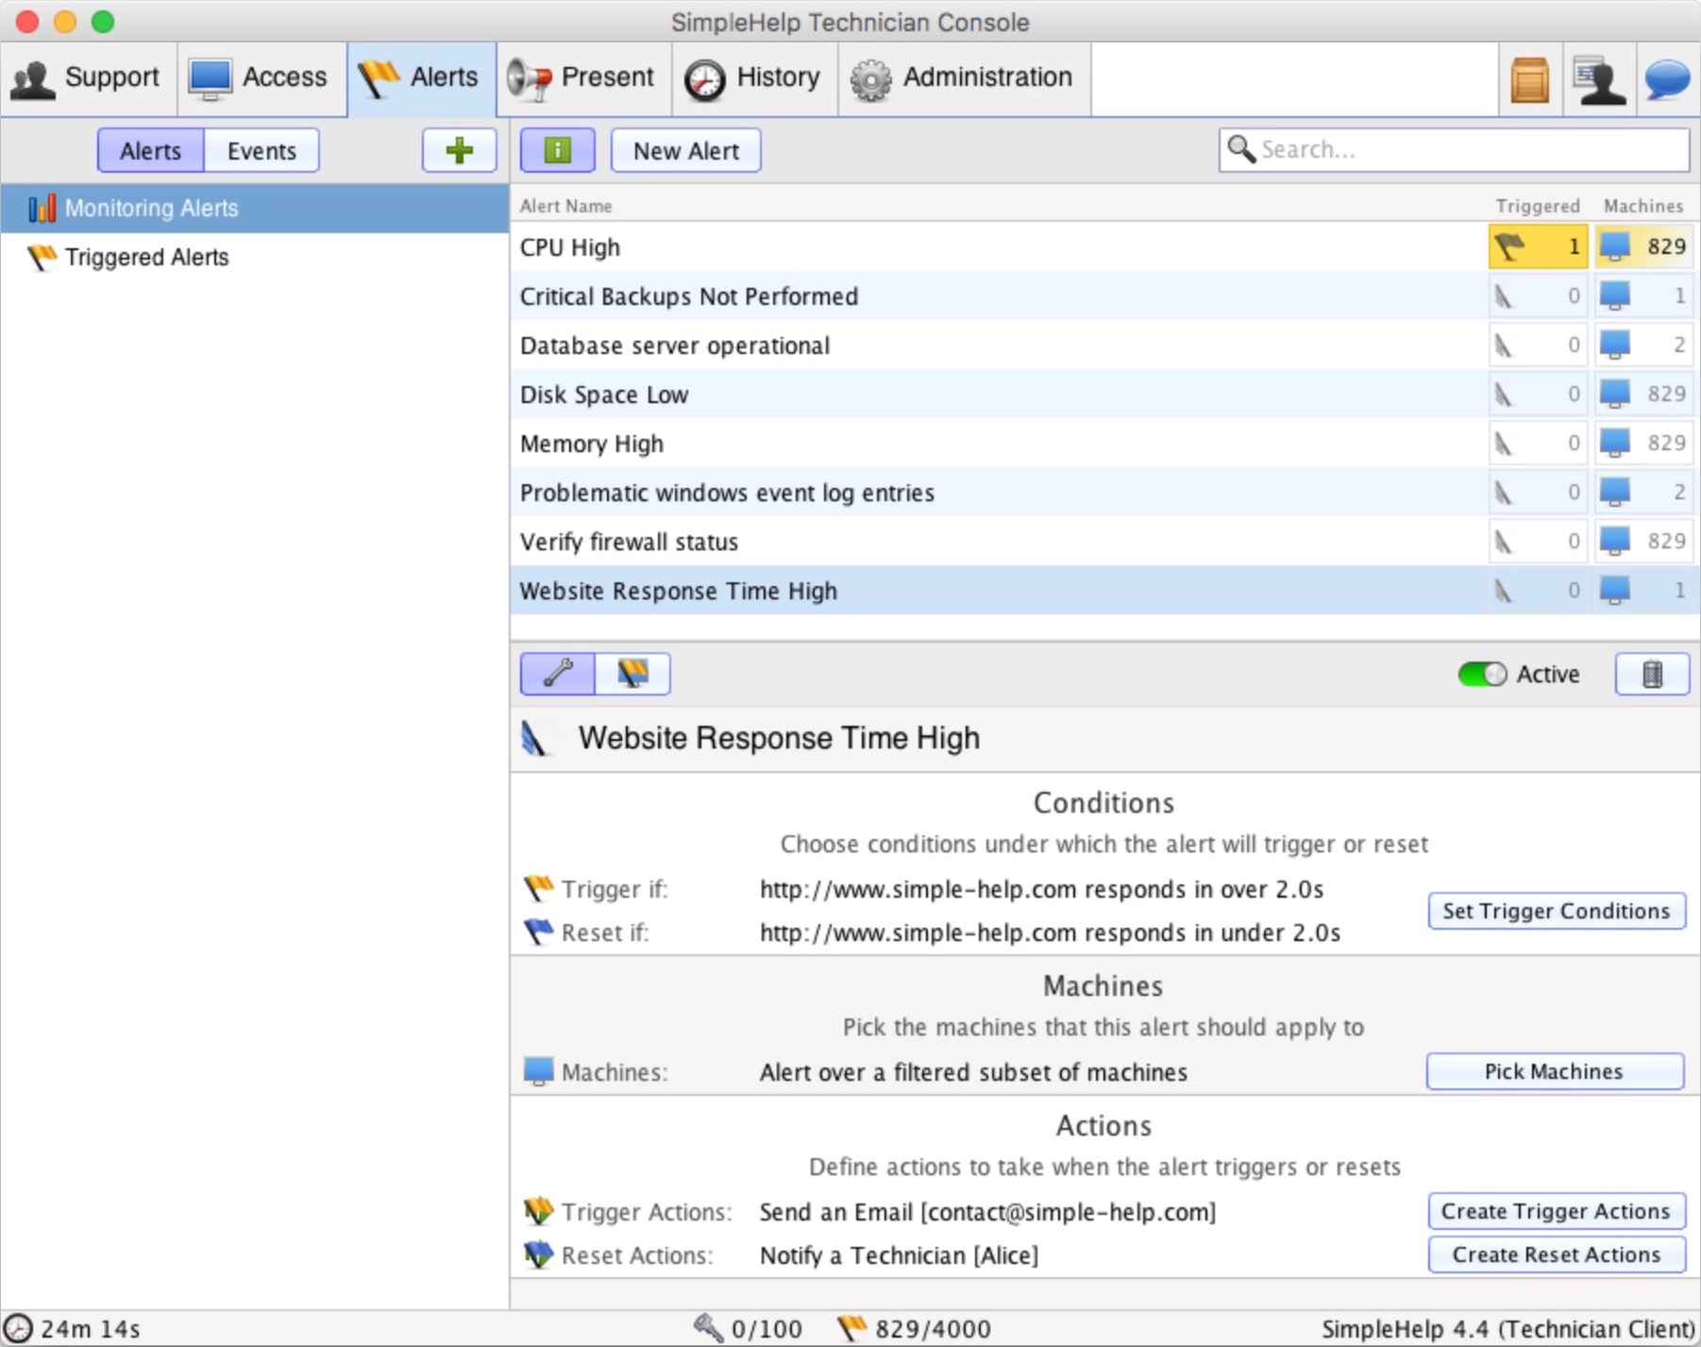
Remote Management
Alerts provide constant, frequent checks over critical systems, frequent user issues
Flexible action system can notify technician, take remedial action
Issues are anticipated, resolved before they become a problem
Mass tools allow Technicians to perform maintenance, fixes across large groups of machines
www.simple-help.com
© simplehelp ltd

Slide 7
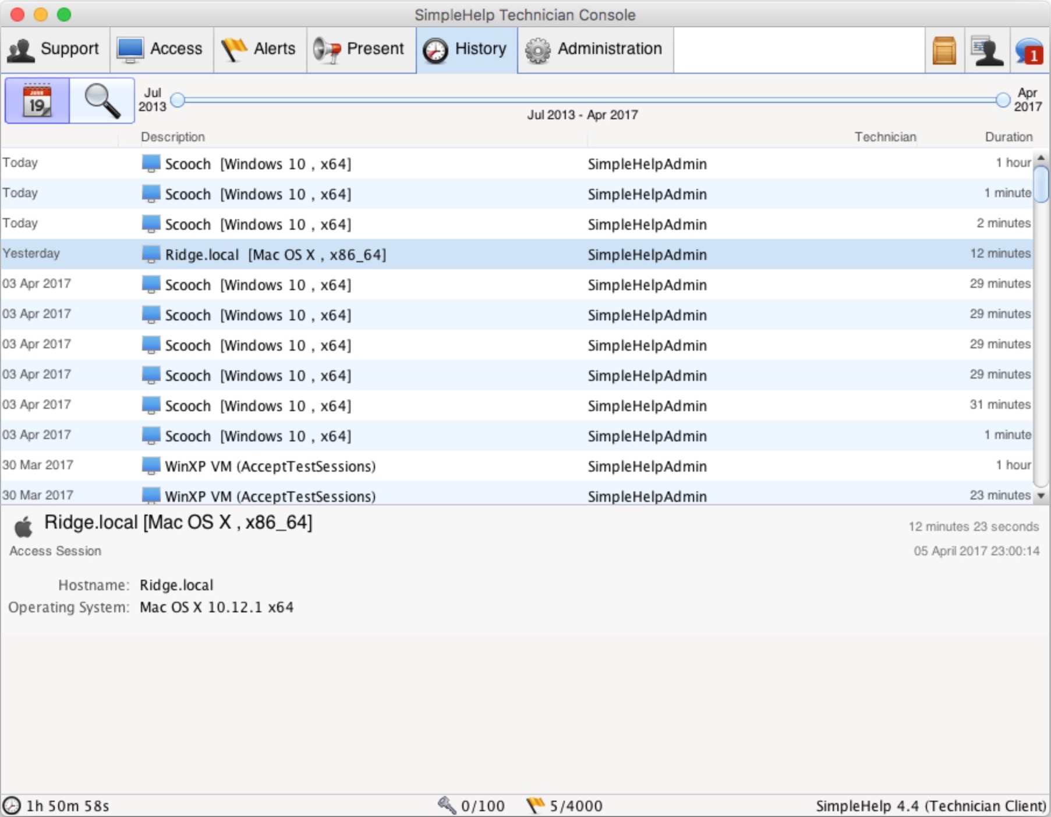
Self Hosting Benefits
Integration with your existing systems, authentication
Updates happen on your schedule
In-house controls on access, permissions, sharing
All data flows only through your network
www.simple-help.com
© simplehelp ltd

Slide 8
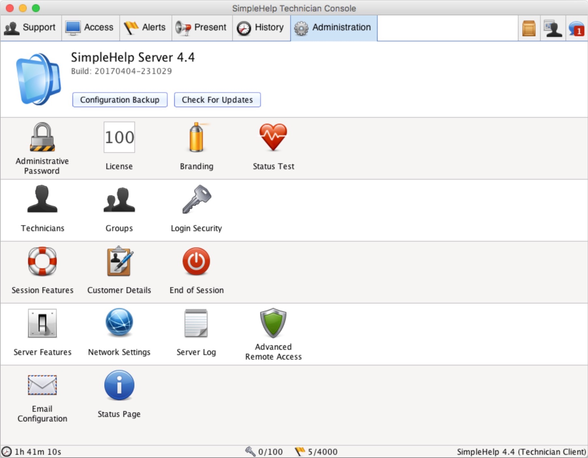
Enterprise
High Availability Failover transfers live (support, customer, access) to a secondary or tertiary server
Clustering for large scale remote access deployments
LDAP/AD, RADIUS, Two Factor, TOTP, redundant auth servers
No additional costs for failover or clustering servers
www.simple-help.com
© simplehelp ltd

Slide 9
UK based since 2007
4500+ SimpleHelp servers operational worldwide, proven in Enterprise
Decades of developer experience with high performance scalable systems
Extended trials available on request
www.simple-help.com
© simplehelp ltd

